Slide 1
ReLayNet: retiNal layer and fluid segmentation of OCT using CNN
Paper by Abhijit Roy, Sailesh Conjet, Sri Karr, Debdoot Sheet, Amin Katouzian, Christian Wachinger, and Nassir Navab
Presentation by Zhenyao Cai
Notes:
Hello everyone, today I’ll talk about a not so popular algorithm which uses image processing approach to solve biological problems.
The paper I used is called Relynet, retinal layer and fluid segmentation of oct using Cnn

Slide 2
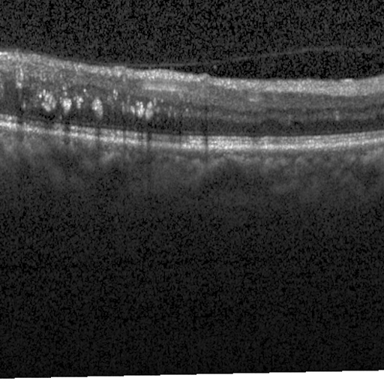
The Goal
The goal is to segment the retinal layer and fluid of macular OCT (Optical Coherence Tomography).
In the image on the right, you can see what an OCT looks like,
It is mainly used for non-invasive diagnosis of diabetic macular
Edema assessing the retinal layers.
Notes:
The problem stated in the paper is to segment the retinal layer and fluid of macular OCT or optical coherence tomography. The picture on the right is an example of what an OCT looks like, so it is basically consists of the retinal layer and fluid, and the main goal in the paper is to segment the layers. This solution is quite important in the field, because the retinal layers are important for examination of the situation of diabetic patients in order to prevent the occurrence of blindness.

Slide 3
Reasons For Choosing this topic
I am very interested in image segmentation using deep learning approach.
OCT images are simple, so it doesn’t require a complex CNN architecture. The 8-layer architecture allows simple implementation.
Notes:
Two reasons lead me to choose this paper is that first, I am interested in image segmentation using deep learning approach, and second is that because OCT images are simple, so it doesn’t require a complex CNN architecture, and this makes the implementation of this CNN model possible

Slide 4
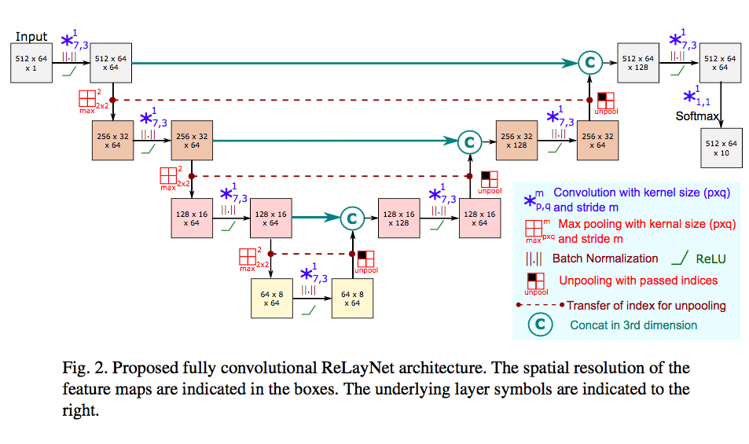
Proposed Methodology in the paper
Problem – classify the pixels in 10 categories(layers) by the pixel information.
CNN-model
Composite loss function
Notes:
In the paper, there are basically two important methodology. First is the CNN-model, which is an eight-layer model. In each layer, a convolution fielter size, stride and the padding are chosen, and Rectified Linear Units layer and pooling or un-pooling layers are also applied. Another thing is that the model is trained with composite loss functions, which comprises two things, one is the cross-entropy of the target images and input images, the other is the penalty at layer boundaries. The loss function is used to optimize the parameter values in a neural network model and the composite loss function approach optimizes the cnn model.

Slide 5
Implementation
Language:
Python 3.6
Modules, Packages, Libraries:
cv2 is in opencv package, which is used to read images in grayscal
numpy is used to store and process the image information as a matrix
tensorflow is an open library for machine learning
Notes:
Three important libraries used in the implementation: cv2 is in opencv package, which is used to read images in grayscale; numpy is used to store and process the image information as a matrix; tensorflow is an open library for machine learning, the training steps and optimization are automatically done by using tensorflow built in functions, so it is efficient to build CNN models by using tensorflow.

Slide 6
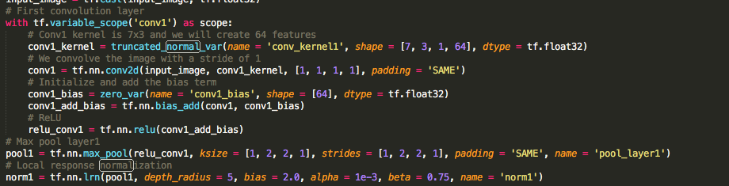
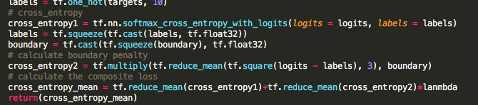

Implementation
Functions:
Cnn_model
Loss function
Accuracy
Notes:
The Cnn model proposed in the paper has 8 layers, here I just show the first layer. It shows how to use tensorflow built in functions to apply convolution fielter, relu layer, and pooling layer to the image. The two parts of loss function mentioned in the paper can also be done by tensor flow easily. Cross entropy is a built in function of tensorflow, and to get the boundary penalty needs some simple calculation. The last function is to get an accuracy rate comparing a prediction image with a target image.

Slide 7
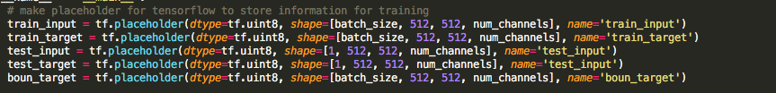

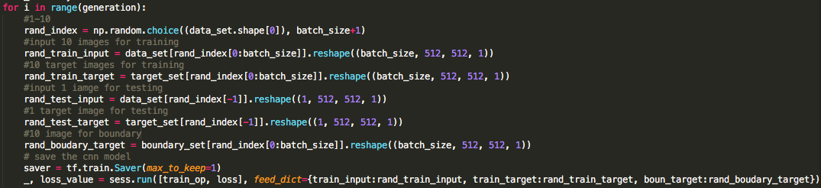
Implementation
Model building and training
Notes:
Create placeholder to store the input data information in each iteration, and call the cnn_model function to build the model using the place holders, and to train the model, is by feeding the image information into the placeholder.

Slide 8
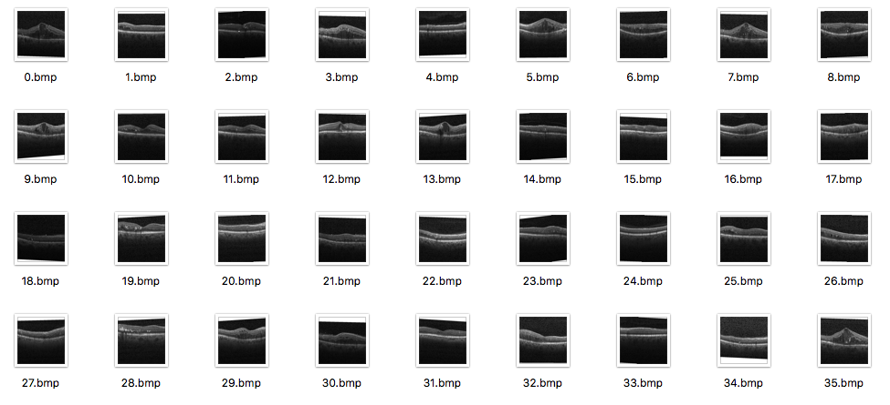
Implementation
Dataset and initial training values
The dataset is a Duke SD-OCT publicly available dataset for DME patients.
Maximum number of iterations is 3000,
Each time feed in 10 test images
Generate loss and accuracy rate after
Every 50 iterations
Notes:
The dataset is a Duke SD-OCT publicly available dataset for DME patients. The data is originally stored in .mat file, so I wrote code to save the image files in order to import them in python.
I experiment the program with 100 images in the dataset. The maximum number of iterations 3000, each time feed in 10 test images, and after 50 iterations, generate the loss and accuracy rate. For the training step, I set the initial learning rate as 0.002, the decay steps as 25, and the decay rate as 0.9.

Slide 9
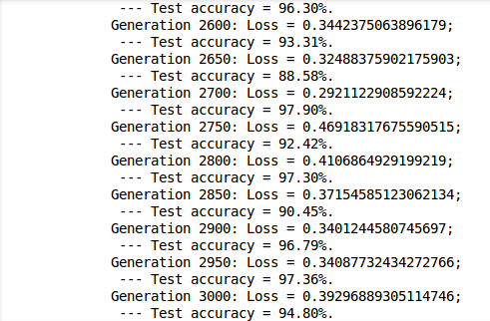
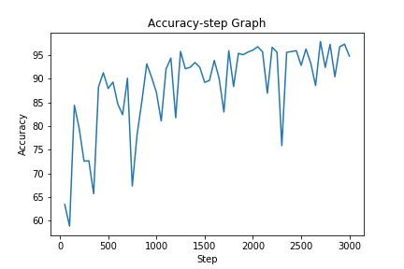
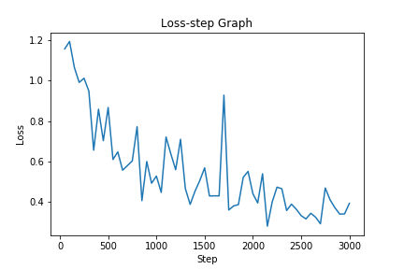
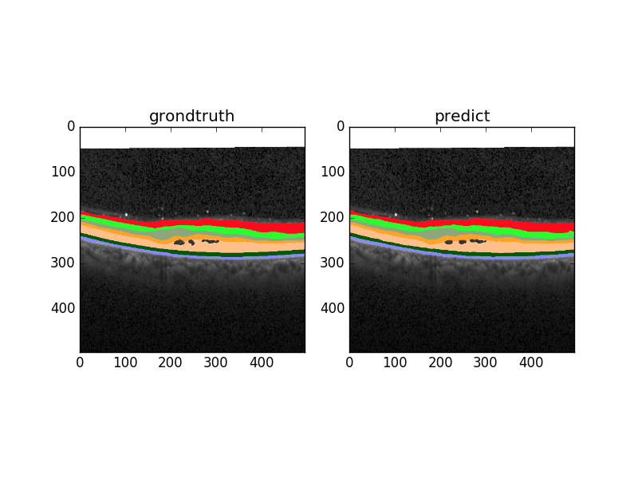
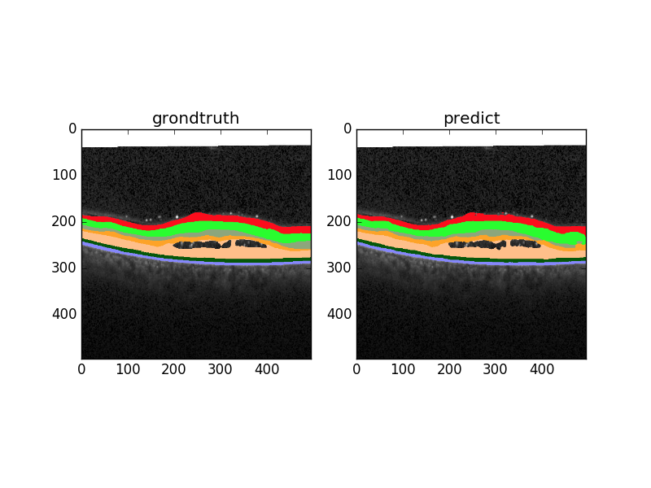
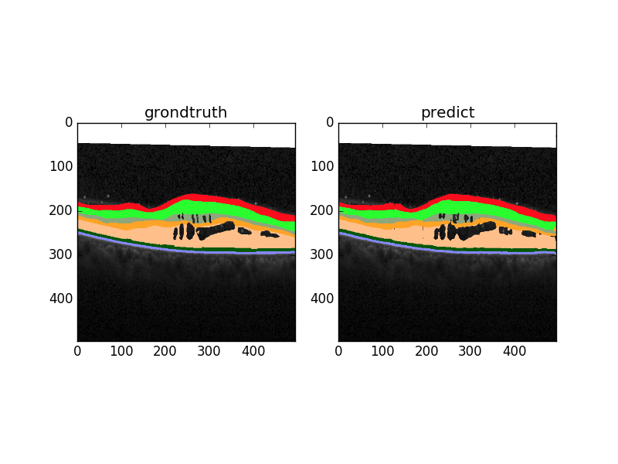
Result
Notes:
The result shows that even though there are some fluctuations, the loss decreases gradually, and the accuracy rate increases gradually. After 3000 training iterations, the accuracy rate approaches 95%.
The coloring of the predicted layer after training also shows the accuracy of the prediction comparing to the target segmentation.

Slide 10
Challenges
Slow -> GPU, and python packages
Understanding tensorflow library.
The loss function and optimization part in the paper are hard to understand.
Finding image dataset is difficult.
Notes:
Building a deep neural network is extremely slow, so I could not use my laptop to run the code, but using GPU. Though using GPU, it still takes around 1 hour to complete training the model.
Understanding tensorflow library is also a challenge for me. It took me a while to understand how to build CNN layers by using tensorflow, and how to feed in numpy array data into the CNN model.
Besides, the loss function and optimization part in the paper are all about mathematics which is very hard to understand.

Slide 11
Future work
It may be applied to other simple image segmentation problems that have less than 10 classes of pixels. Because this cnn model is fairly simple, so it cannot solve more complicated problems such as face detection or object detection which might need up to hundreds of layers.
Notes:
It may be applied to other simple image segmentation problems that have less than 10 classes of pixels (10 objects). More complicated CNN solvable problems, such as face detection or object detection might need up to hundreds of layers. Thus, this simple architecture, though not hard to implement, has very limited usage.

